Slide 1
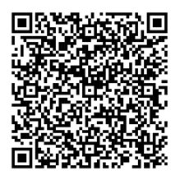
Heading
Heading
Only 1 slide per poster is permitted
The layout of this poster is an example for you to follow should you choose to do so. However interactive presenters are free to use the space within this template as they wish
The following items are mandatory and must be included:
    Branding at the top and bottom of the template must remain
    Title of presentation
    Author information
This template has been configured to be the correct size for your poster display – A0 portrait style.
Your display should be self explanatory
Do not present too many details on the poster, instead be prepared to discuss points with participants
Posters should include the name and affiliation of the lead author to facilitate identification at the congress
All text, lettering, diagrams and photographs should be large enough to be legible at a distance of 1.5m
Lettering for titles should be 24 point minimum and preferably in Arial font
The use of figures and charts is suggested, avoiding excessive text
Text appearing on the poster is to be written in English
Aim to put across a simple message in an eye-catching manner
To add interactivity to your poster presentation, please scan the QR code for helpful tips and ideas:
Heading
Heading
Incorporating Interactivity (optional)
Make your poster engaging by integrating interactive elements such as:
QR Codes:
  Generate and place QR codes strategically to link attendees to additional resources:
  More information (e.g., related articles, references, or website)
  Videos explaining concepts or demonstrating processes
  Survey or feedback forms for audience participation
  Quiz or interactive questions related to your research

